Slide 1
ArcGIS API for JavaScript An Introduction
Kelly Hutchins
Heather Gonzago

Slide 2
Why
Interactive maps
Widgets
Analysis
Lots of samples

Slide 3
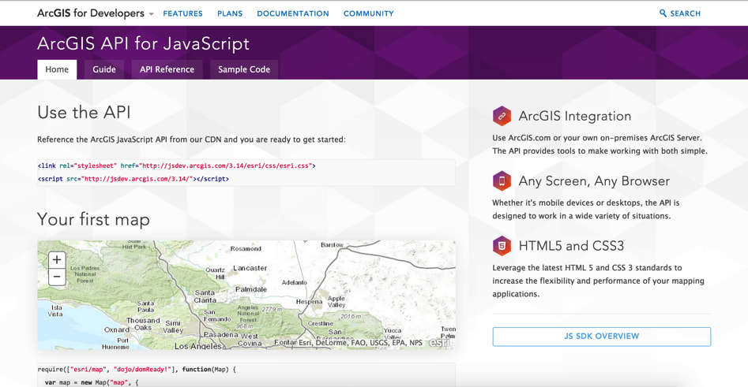
Learn about the API

Slide 4
Developer Setup
IDE (s)
Code Assist
Plugins
?

Slide 5
Build sample app
Widgets, Events, Graphics, Selection

Slide 7
Get the API
Hosted
Download
http://developers.arcgis.com/en/downloads
Notes:
Heather
Where do you get the api

Slide 8
Make a map

Slide 9
Loading Modules
Preferred arg alias

Slide 11
Scrambled Tiles

Slide 12
Basemaps

Slide 13
Developer Console

Slide 14
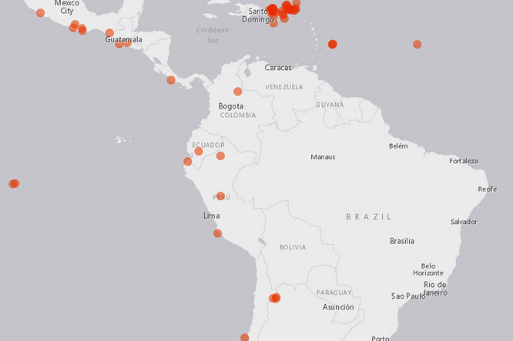
Add Layers
Lots of types
Tiled
Dynamic
Graphics
Feature layers
CSV
KML
WMS/WMTS/WFS
Custom layers

Slide 15
Layer coding pattern
require(["esri/map", "esri/layers/FeatureLayer", "dojo/domReady!"], function(Map, FeatureLayer)
Load module
Create layer
Specify properties
Add layer to map
var featureLayer = new FeatureLayer("http://
sampleserver6.arcgisonline.com/arcgis/rest/services/USA/MapServer/2",{
outFields: ["*”]
});
map.addLayer(featureLayer );

Slide 16
Demo: Add feature layer to application

Slide 17
Deep Dive: Feature Layers
Selection …
Query
Edit
Renderer

Slide 18
Renderers

Slide 19
Demo: Apply renderer

Slide 20
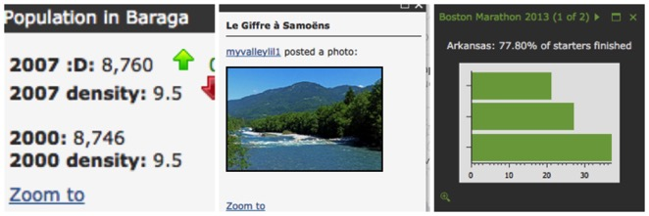
Popups
Add interactivity
Information about ..
A location
A feature
The results of a search
Customizable

Slide 21
Demo: Make map interactive

Slide 22
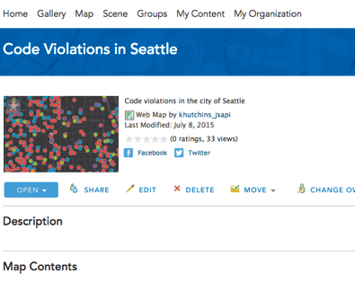
Tip: Reduce code by using a web map
esri/arcgis/utils
createMap

Slide 23
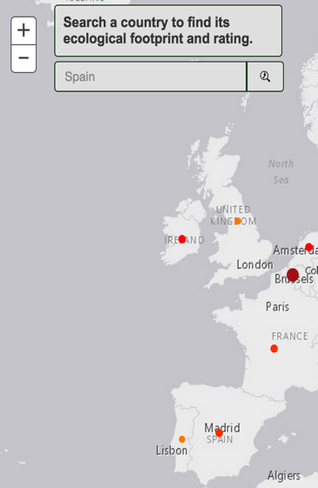
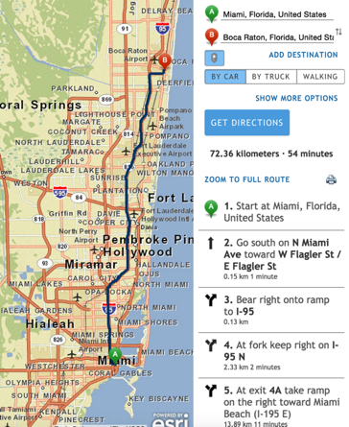
Widgets
Search
Legend,
Directions,
Print,
Basemap Toggle,
etc

Slide 24
Widget coding pattern
Load module
Create widget
Set widget properties
Call startup

Slide 25
Demo: Add search widget

Slide 26
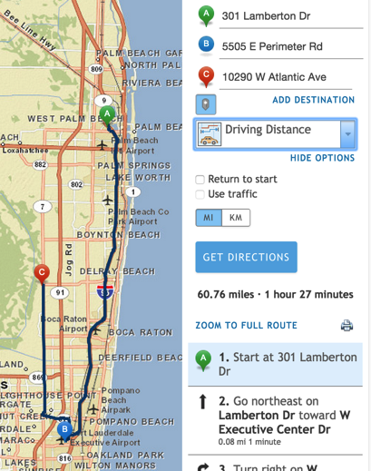
Demo: Directions widget
Requires credit-based route service

Slide 27
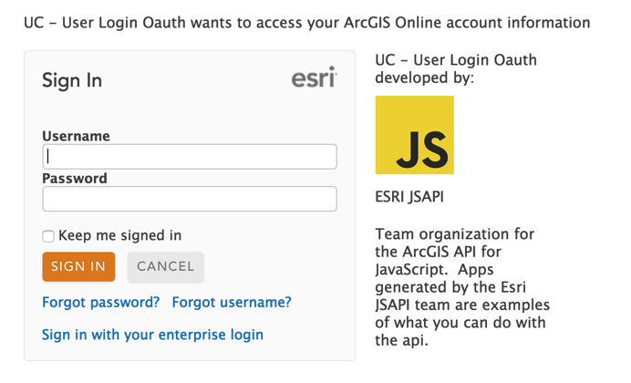
Tip: Working with secure resources
Identity Manager
OAuth Support
Proxies

Slide 28
Demo: Customize widget appearance

Slide 29
Events
Event handlers
Load page, click map, execute task, add layer ….
dojo/on

Slide 30
Want to learn more?
Documentation
https://developers.arcgis.com/javascript/
Dojo documentation
Related Esri Training and Tutorials
Esri class: Building Applications with the ArcGIS API for JavaScript
Esri webinar: Data visualization and time saving tips
Additional Resources
JavaScript online training classes: free and fee-based

Slide 31
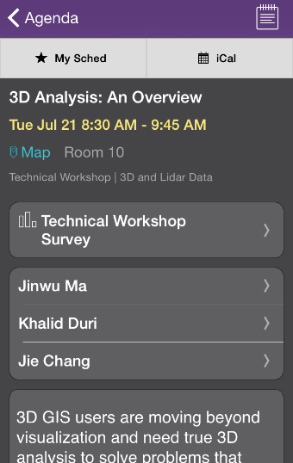
Thank you…
Please fill out the session survey in your mobile app
Select [enter session title here] in the Mobile App
Use the Search Feature to quickly find this title
Click “Technical Workshop Survey”
Answer a few short questions and enter any comments

